Slide 1
Hotter Climates and Violent Storms
November 5th, 2023
Daniel Craig

Slide 2
Overview
As Earth’s climate is increasing in temperature, hurricanes and tornadoes both seem to be increasing in occurrence and intensity. Hurricane Jeanne (2004) ravaged Haiti and the Bahamas leaving 3,000 dead. Hurricane Mitch (1998) battered Honduras and Nicaragua for 9,000 lives. Hurricane Katrina (2005) killed 1,800 and dealt over $160 billion in damages. Tornado Joplin (2011) levelled 4,000 buildings and killed 158 people.
Is this coincidence or are storms growing as temperatures increase? To answer this, first is to establish and measure the power of these storms.
Notes:
Hurricane Facts: Weather Underground (wunderground.com)
Joplin Tornado Fact: 2011 Joplin tornado - Wikipedia

Slide 3
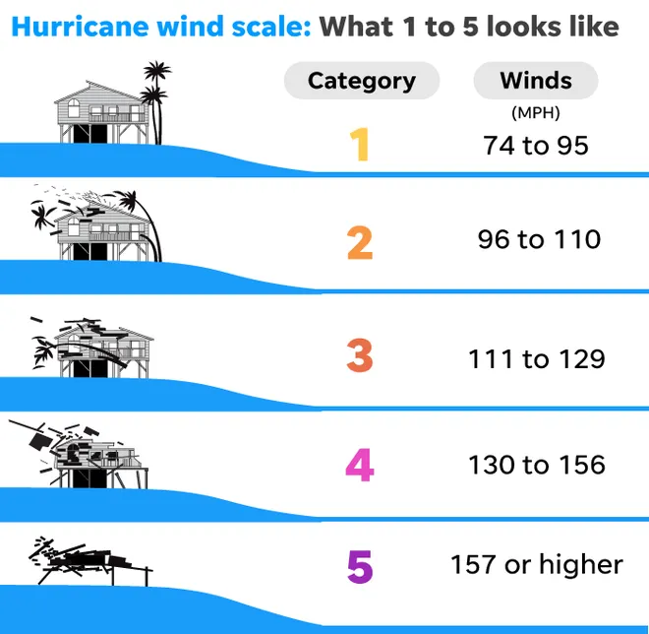
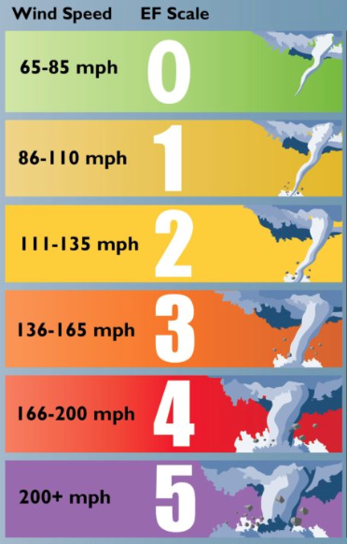
Categorizing the Problem
Hurricanes: Saffir-Simpson Wind Scale
Tornados: Enhanced Fujita Scale
Both the Saffir-Simpson and EF Scales correlate wind speeds to building damage.
0/1 : Slight damage to roofs, sidings, gutters
2: Major roof damage/lost
3: Stories of homes destroyed, loss of electricity
4: Walls/exterior lost
5: Buildings levelled
Notes:
Tornado EF Scale Pic: How damage determines a tornado's rating: From Fujita to Enhanced Fujita - ICC (iccsafe.org)

Slide 4
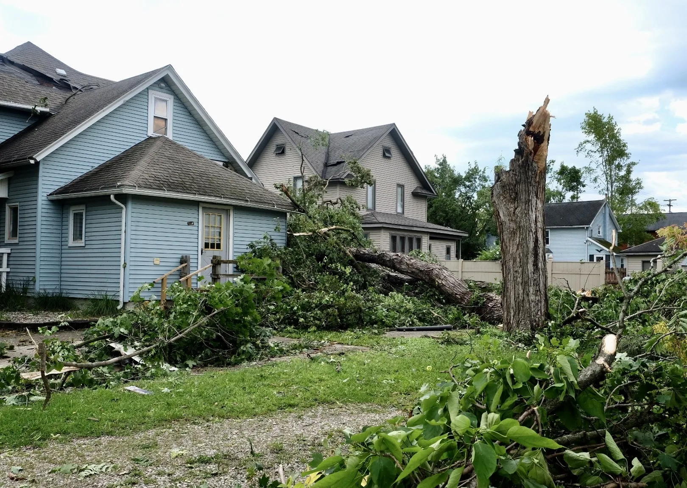
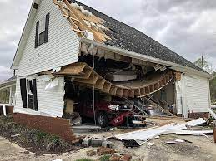
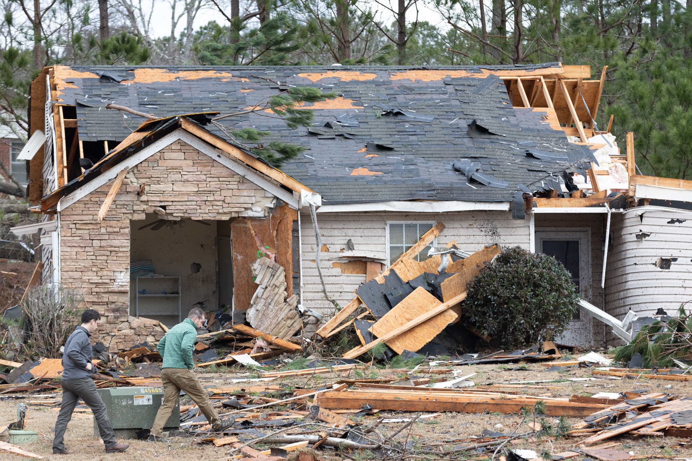
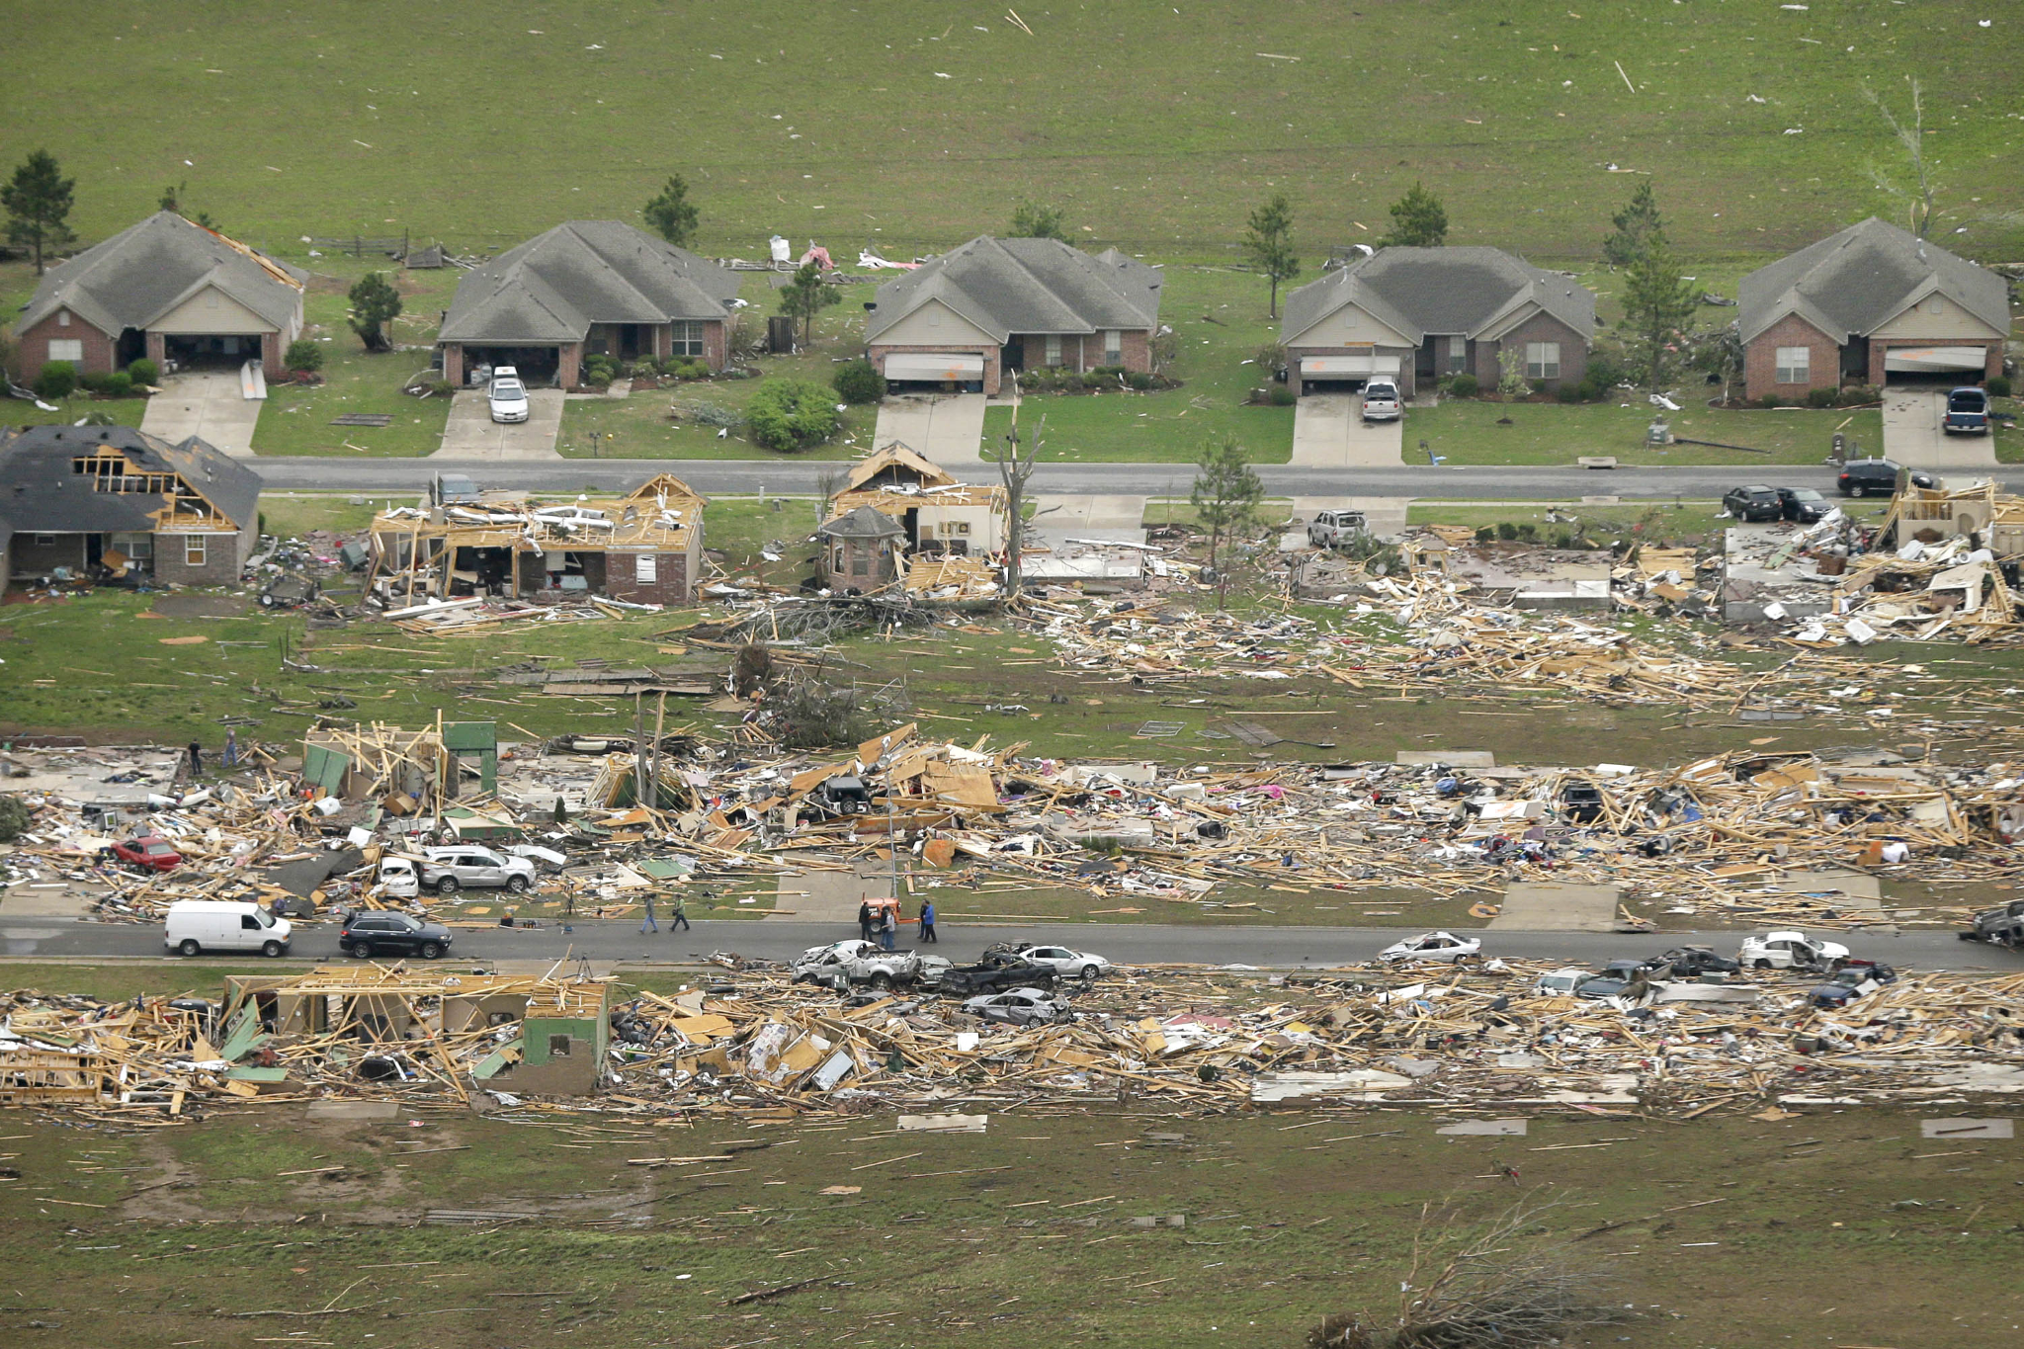
EF 1 Damage
EF 2 Damage
EF 3 Damage
EF 4 Damage
Tornado EF Damage Examples
Notes:
Category 1 Img: https://www.lansingstatejournal.com/gcdn/presto/2023/08/12/PLSJ/119f1e78-4624-41b2-a74b-041c4aee60ea-trees_down.jpg
Category 2 Img: National Weather Service confirms EF2 tornado touched down in Walker County | Chattanooga Times Free Press
Category 3 Img: 4 tornadoes, including EF3, confirmed across 4 Georgia counties (ajc.com)
Category 4 Img: Arkansas Tornado Was EF4; EF2-Rated Twister Hit Oklahoma/Kansas (insurancejournal.com)

Slide 5
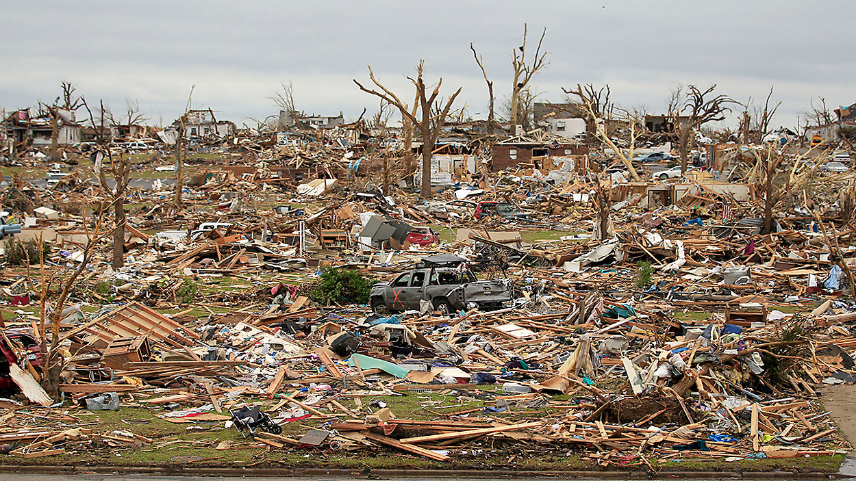
Category 5 Tornado
- 2011 Joplin, Missouri
Notes:
Joplin picture: A look at the biggest and deadliest tornadoes: EF5s (baynews9.com)

Slide 6
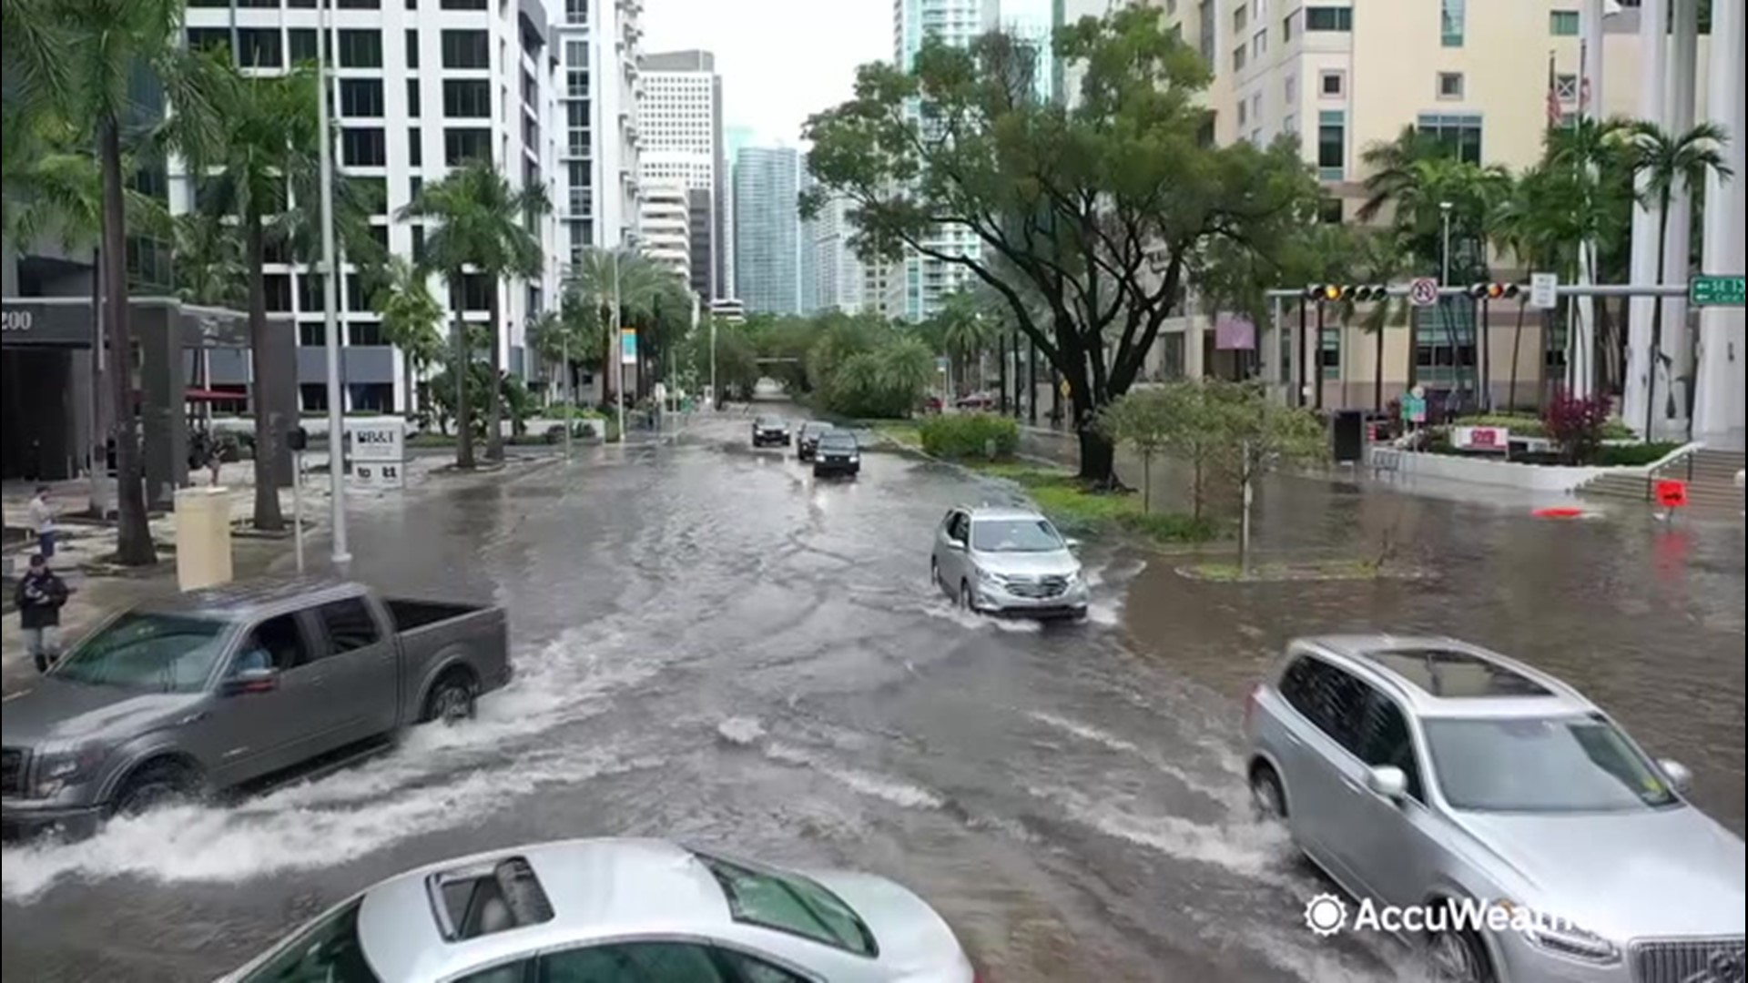
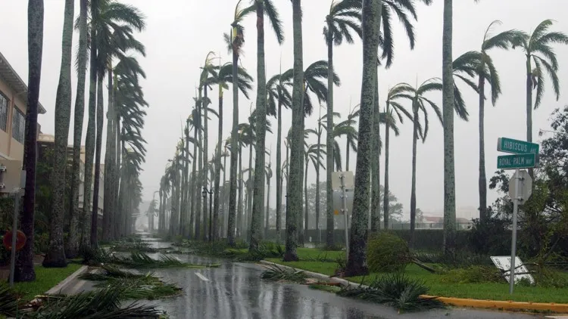
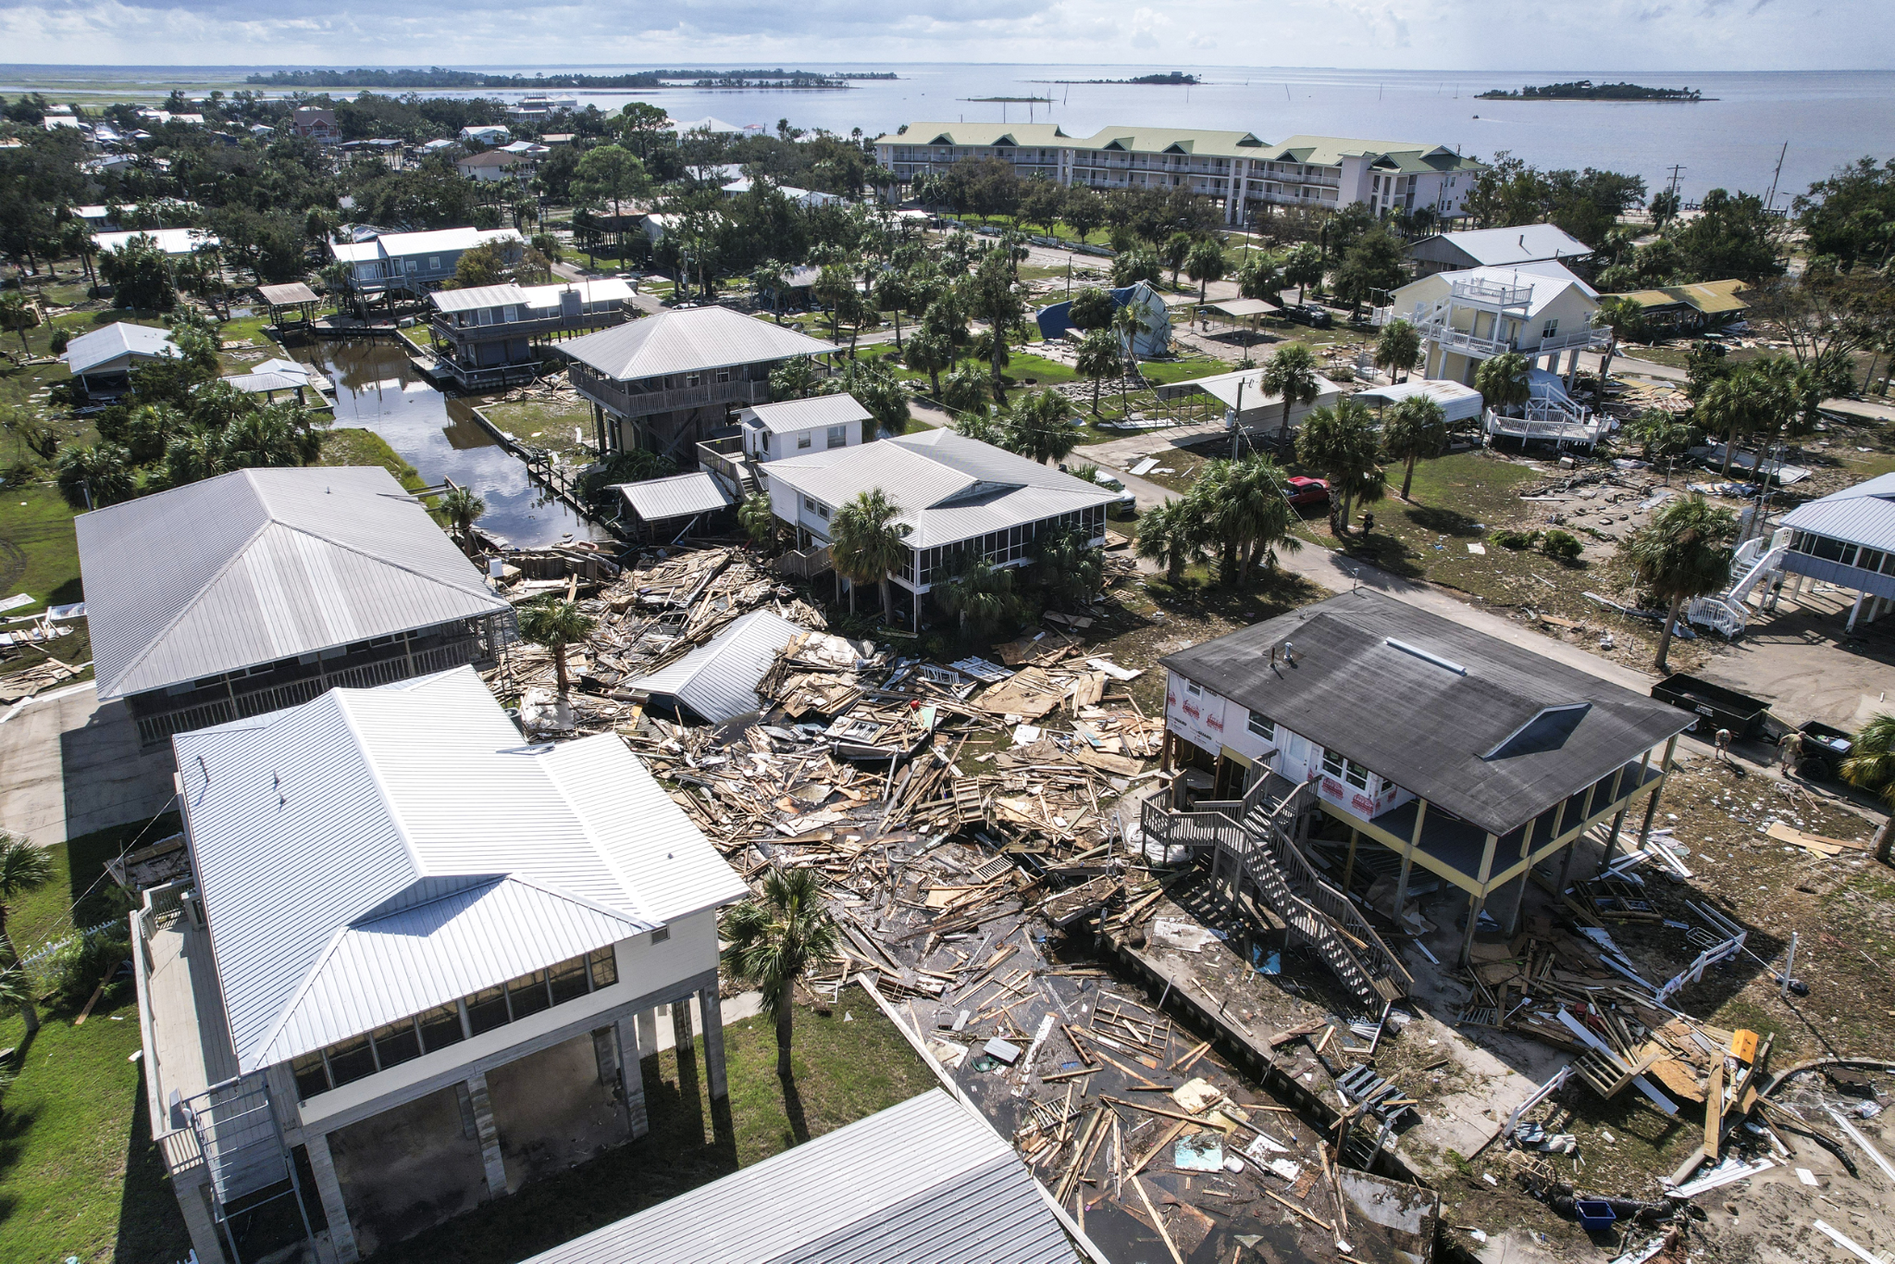
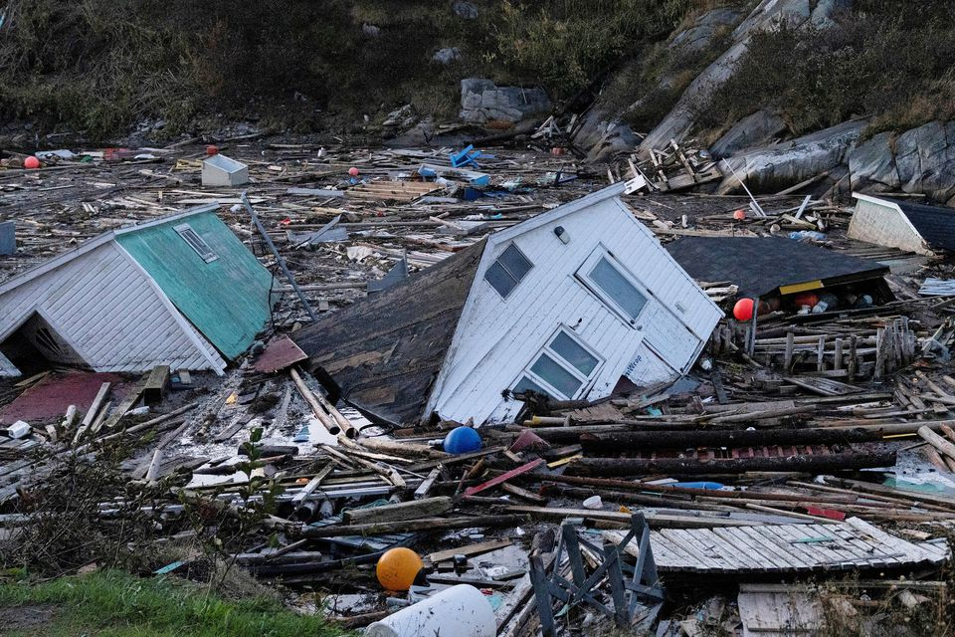
Cat. 1 Damage
Cat. 2 Damage
Cat. 3 Damage
Cat. 4 Damage
Hurricane Catg. Damage Examples
Notes:
Category 1 Img: Eta strengthens into a Category 1 hurricane | 9news.comhttps://www.lansingstatejournal.com/gcdn/presto/2023/08/12/PLSJ/119f1e78-4624-41b2-a74b-041c4aee60ea-trees_down.jpg
Category 2 Img: Hurricane Maria grows to a Category 2, nears already battered Caribbean – The Denver Post
Category 3 Img: Hurricane Idalia could have caused even more damage to Florida. Here's why it didn't. (nbcnews.com)
Category 4 Img: Storm Fiona batters Canada's eastern fishery, farms | Reuters

Slide 7
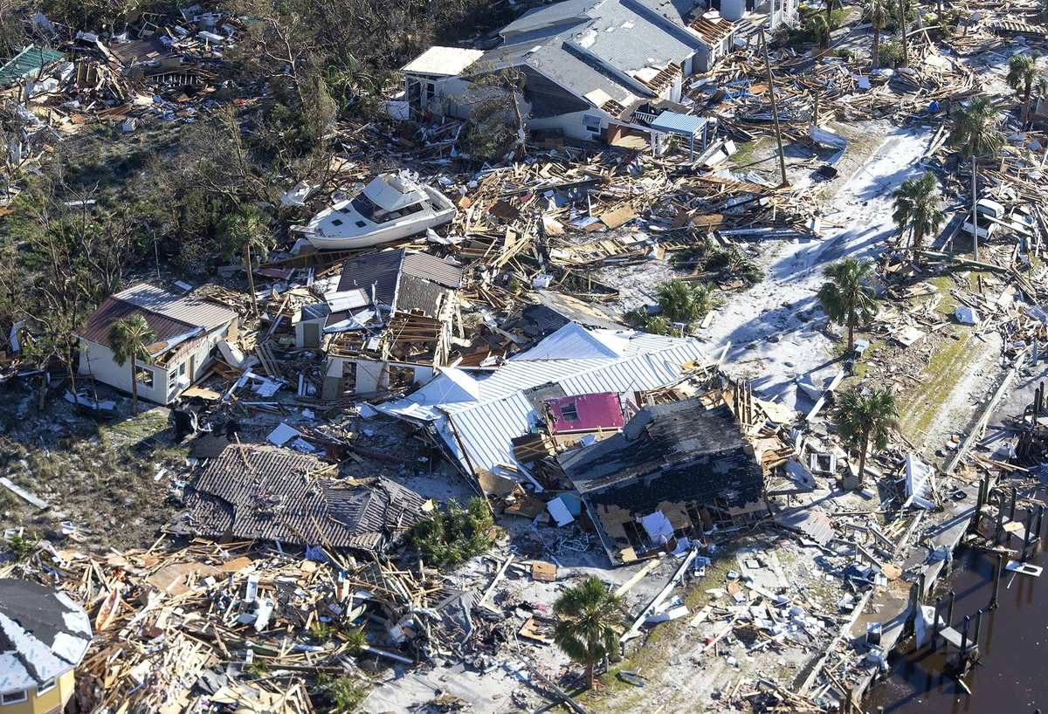
Category 5 Hurricane ‘Michael’
2017, US South East
Notes:
Hurricane Michael Picture: More Photos of the Incredible Devastation Left by Hurricane Michael - The Atlantic

Slide 8
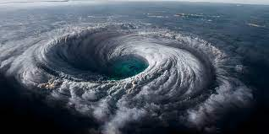
Measuring the Problem
Wind speed and frequency of storms are common measurements of a storm and its season.
The Power Dissemination Index measures activity of cyclones in a season by using cyclone strength, duration, and frequency.
Wind speed(mph)
Number of Storms
Power Dissemination Index
How do storms and their seasons compare over time on these metrics?
Notes:
2023 Hurricane Season: the mid-year outlook | Allianz Commercial

Slide 9
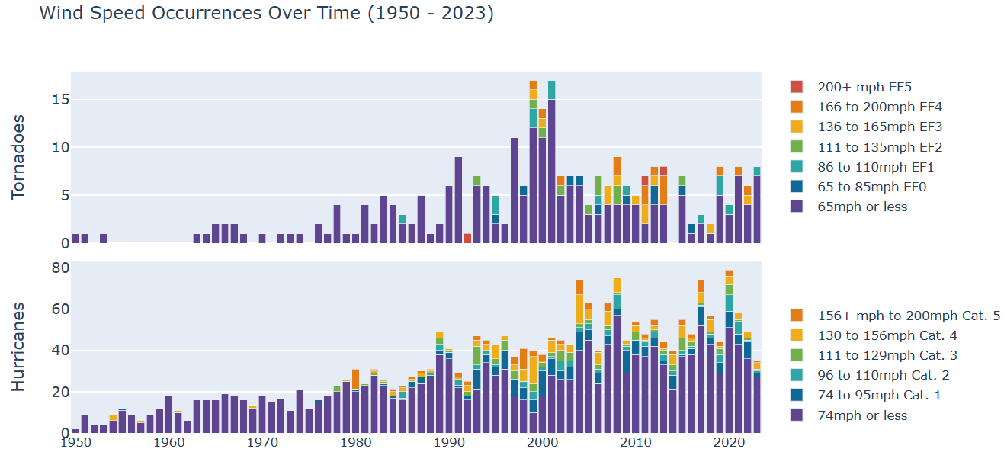
Higher Wind Speeds and Occurrences grow into the 2000s
How does PDI, which summarizes wind and frequency, connect with temperature?
Notes:
2023 Hurricane Season: the mid-year outlook | Allianz Commercial

Slide 10
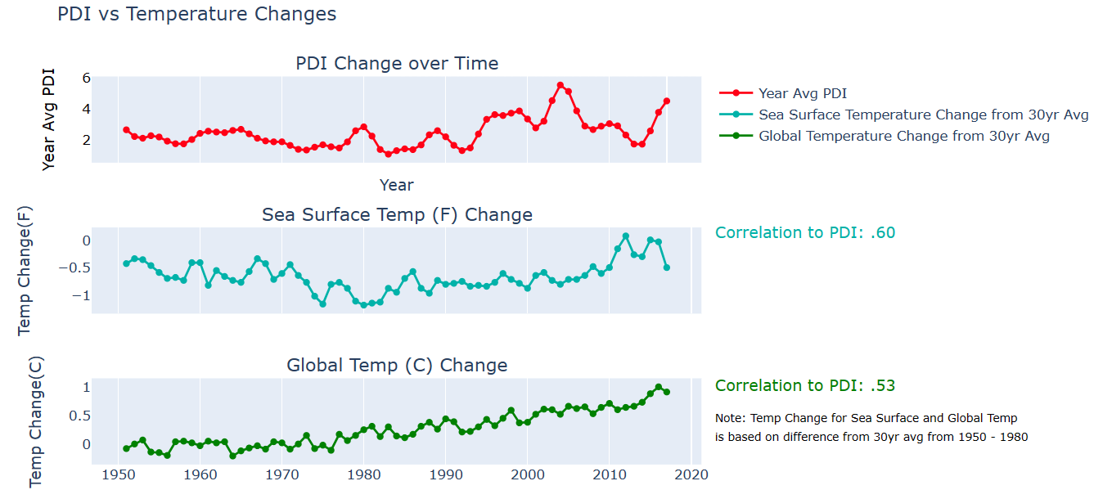
Temperatures are moderately correlated
Is temperature changing and getting hotter?

Slide 11
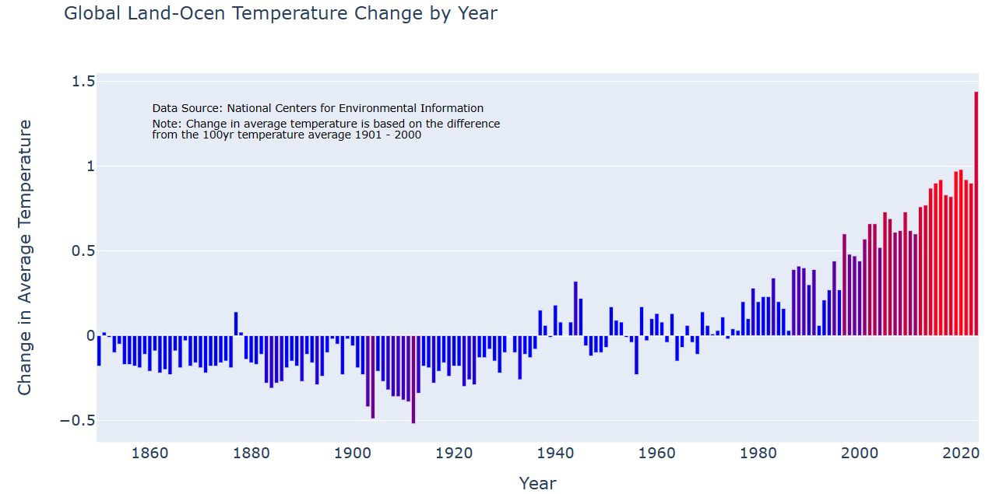
Temperature in the long term is also increasing
If intensity and temperature are growing, so what?

Slide 12
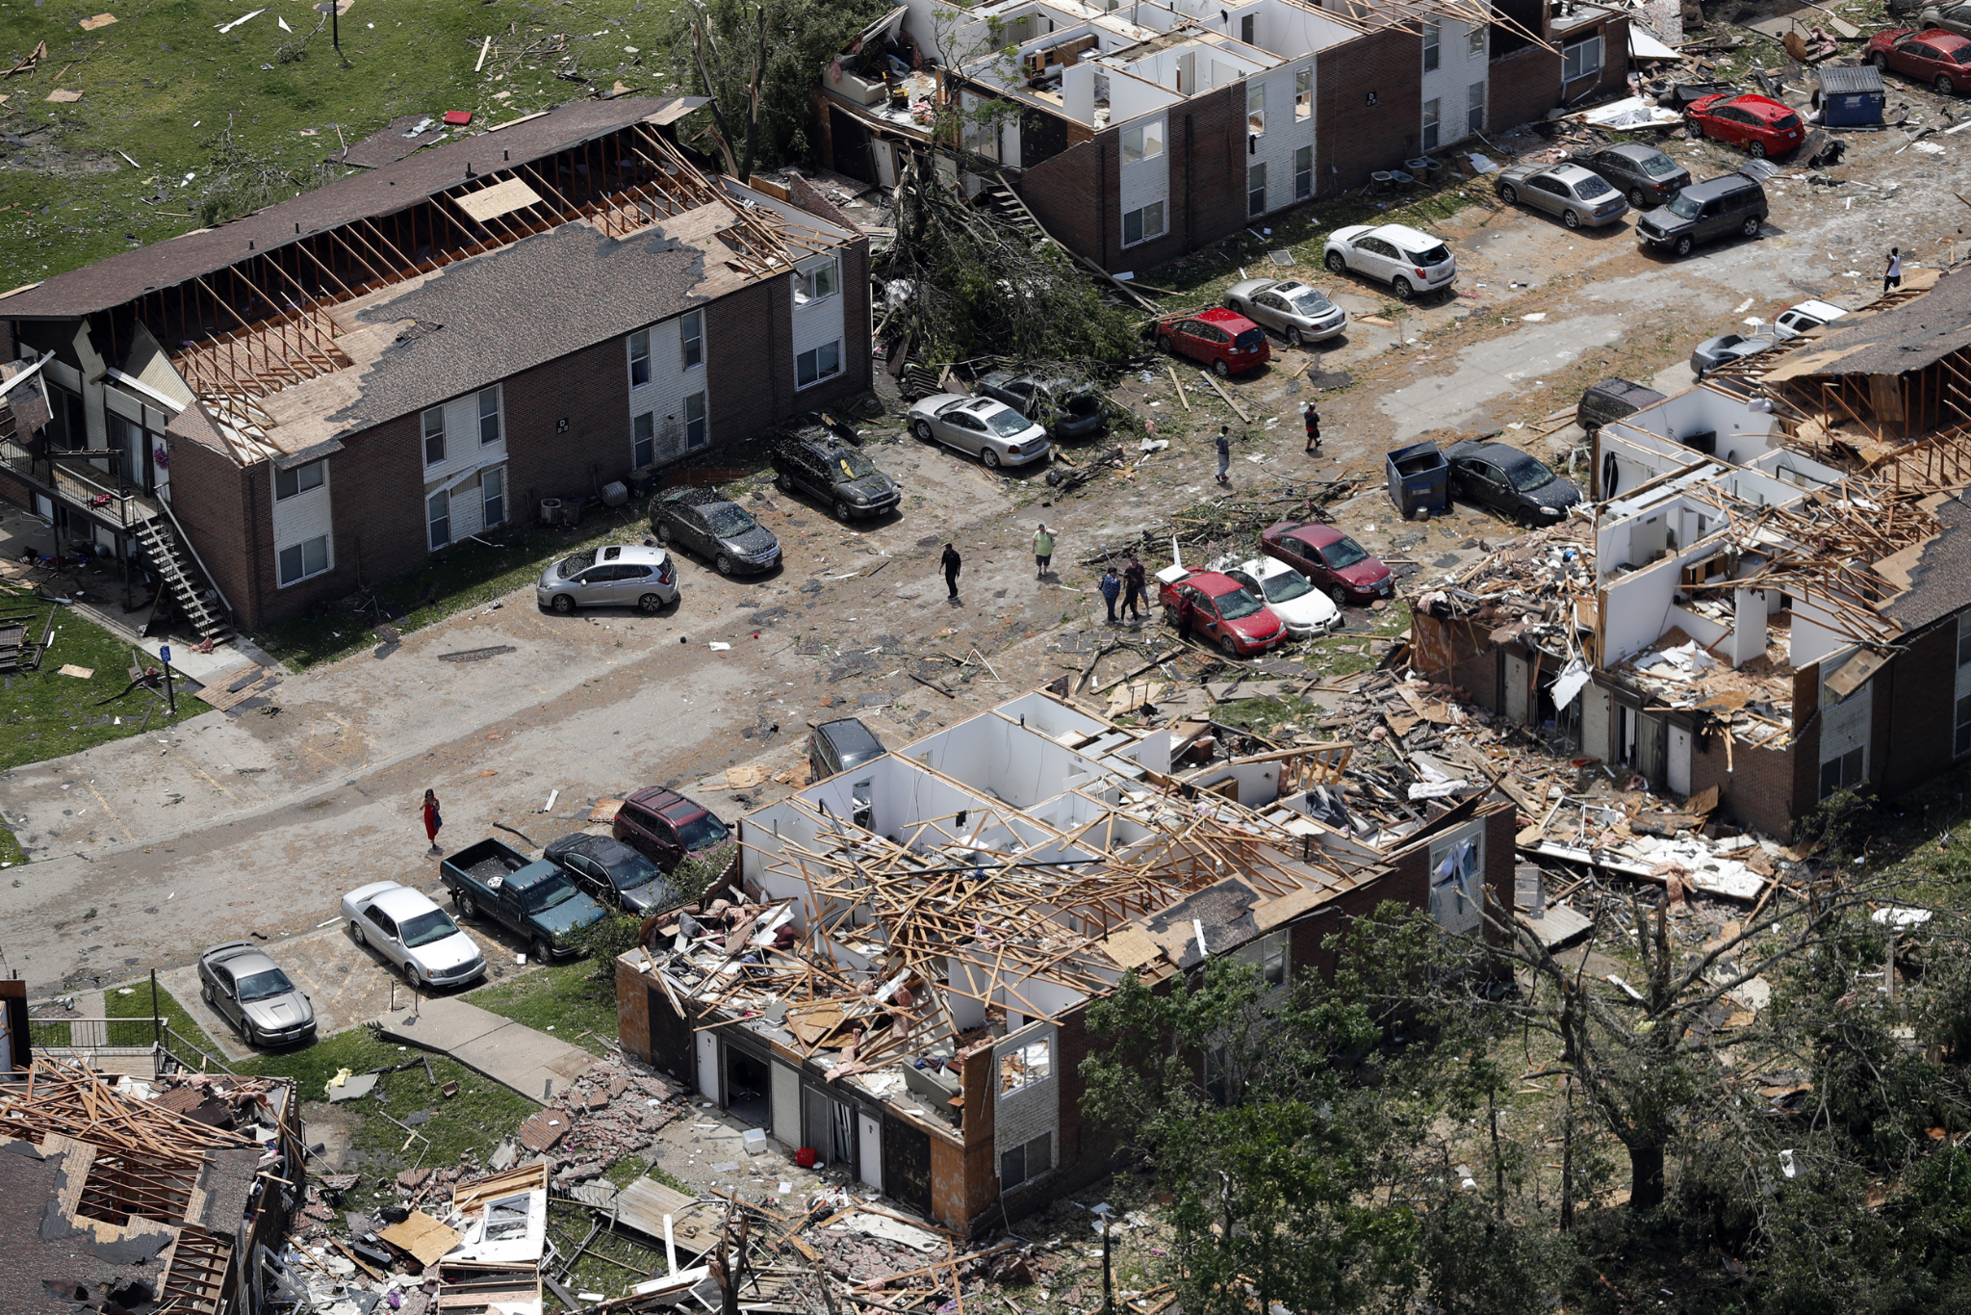
What is the impact?
Damage measured by Cost($USD)
Deaths
If storms are becoming stronger and more frequent over time, is the damage?
How are communities and lives being impacted by these storms?
Notes:
2023 Hurricane Season: the mid-year outlook | Allianz Commercial

Slide 13
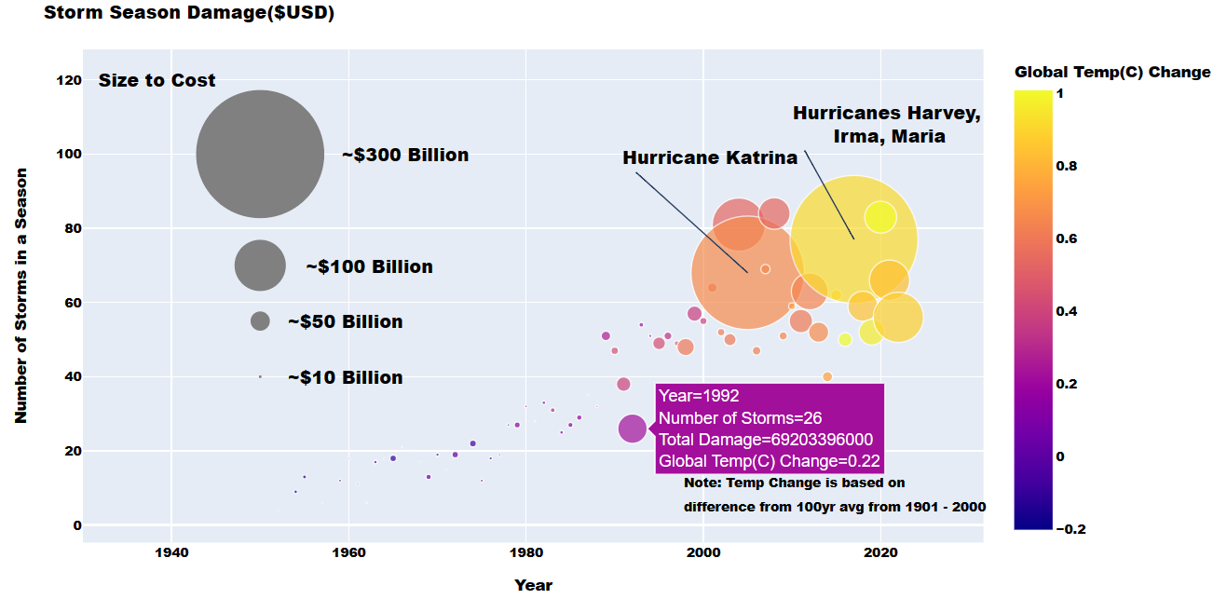
Damage, count, and temperature all have risen since 1950

Slide 14
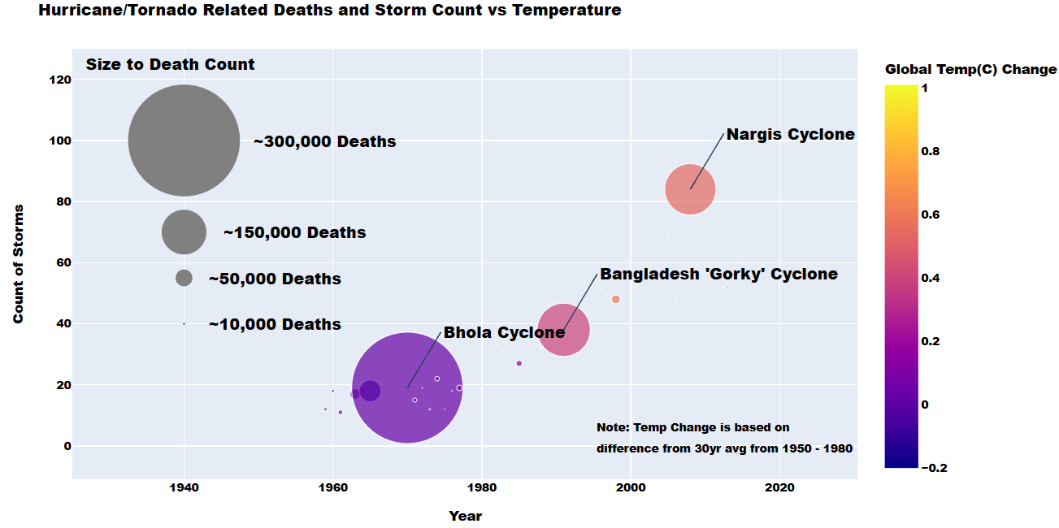
Fortunately, deaths do not have a strong relationship

Slide 15
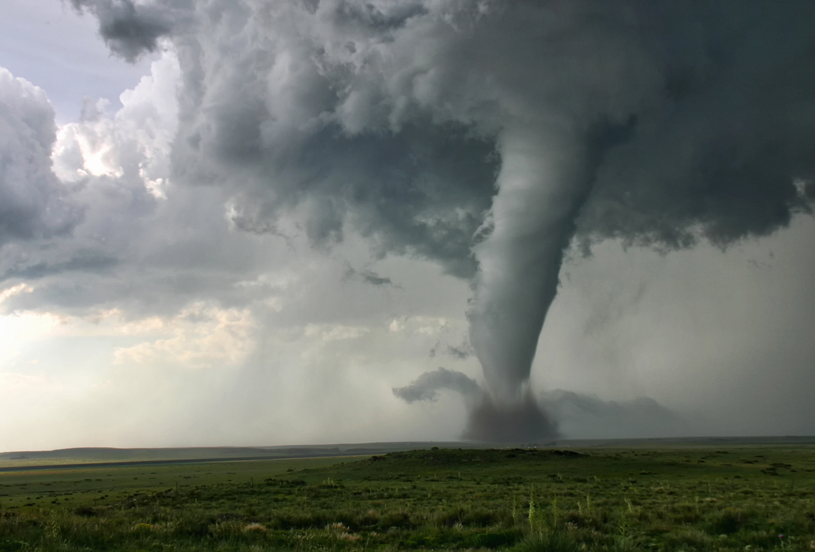
Summary
Over Time
All metrics of intensity observed here, except deaths, increase over time and with a moderate correlation between Power Dissemination Index and temperature.
The correlation between storm intensity and temperature is at least noteworthy if considering how to approach methods of damage mitigation.
Wind (mph) increased
Damage increased
PDI increased
Temperature increased
Notes:
2023 Hurricane Season: the mid-year outlook | Allianz Commercial

Slide 16
Data Sources/Code Appendix:
Global Land Ocean Temperature Change by Year (1901-2000): https://www.ncei.noaa.gov/access/monitoring/climate-at-a-glance/global/time-series
Hurricance/Tornado Related Deaths and Storm Count vs Temperature:
https://public.emdat.be/
Sea-Surface Temperature: https://www.epa.gov/climate-indicators/climate-change-indicators-sea-surface-temperature
PDI Index Season Values: https://www.epa.gov/climate-indicators/climate-change-indicators-tropical-cyclone-activity
Global Land Ocean Temperature Change 1950 - 2020: https://www.nasa.gov/stem-content/global-land-ocean-temperature-index-data-set

Slide 17
APA Data Sources:
Global Time Series | Climate at a Glance | National Centers for Environmental Information (NCEI). (2023, November 5). Global Time Series | Climate at a Glance | National Centers for Environmental Information (NCEI). https://www.ncei.noaa.gov/access/monitoring/climate-at-a-glance/global/time-series
Public EM-DAT platform. (n.d.). Public EM-DAT platform. Retrieved October 30, 2023, from https://public.emdat.be/
Climate Change Indicators: Sea Surface Temperature. (n.d.). Climate Change Indicators: Sea Surface Temperature. Retrieved November 5, 2023, from https://www.epa.gov/climate-indicators/climate-change-indicators-sea-surface-temperature
Climate Change Indicators: Tropical Cyclone Activity. (2023, November 5). Climate Change Indicators: Tropical Cyclone Activity. https://www.epa.gov/climate-indicators/climate-change-indicators-tropical-cyclone-activity
Global Land-Ocean Temperature Index Data Set - NASA. (n.d.). Global Land-Ocean Temperature Index Data Set - NASA. Retrieved November 5, 2023, from https://www.nasa.gov/stem-content/global-land-ocean-temperature-index-data-set/

Slide 18
APA Image Sources:
How damage determines a tornado's rating: From Fujita to Enhanced Fujita. (2023, November 5). How damage determines a tornado's rating: From Fujita to Enhanced Fujita. https://www.iccsafe.org/building-safety-journal/bsj-dives/how-damage-determines-a-tornados-rating-from-fujita-to-enhanced-fujita/
What is a category 2 hurricane?. (2018, September 11). What is a category 2 hurricane?. WKYC Studios. https://www.wkyc.com/article/news/nation-world/what-is-category-4-hurricane/95-592865654
Lansing State Journal. (2023, November 5). Lansing State Journal. https://www.lansingstatejournal.com/gcdn/presto/2023/08/12/PLSJ/119f1e78-4624-41b2-a74b-041c4aee60ea-trees_down.jpg
National Weather Service confirms EF2 tornado touched down in Walker County | Chattanooga Times Free Press. (2020, November 5). National Weather Service confirms EF2 tornado touched down in Walker County | Chattanooga Times Free Press. https://www.timesfreepress.com/news/2020/apr/16/national-weather-service-confirms-ef-2-tornado-wal/
4 tornadoes, including EF3, confirmed across 4 Georgia counties. (n.d.). 4 tornadoes, including EF3, confirmed across 4 Georgia counties. The Atlanta Journal-constitution. https://www.ajc.com/news/fridays-weather-cold-clear-weather-shines-light-on-storms-damage/VB2DBBN3BVDK5JDDOMCYETEKZU/
Arkansas Tornado Was EF4; EF2-Rated Twister Hit Oklahoma/Kansas. (2014, November 5). Arkansas Tornado Was EF4; EF2-Rated Twister Hit Oklahoma/Kansas. https://www.insurancejournal.com/magazines/mag-features/2014/05/19/329019.htm

Slide 19
APA Image Sources:
A look at the biggest and deadliest tornadoes: EF5s. (2021, March 22). A look at the biggest and deadliest tornadoes: EF5s. https://baynews9.com/fl/tampa/weather/2021/03/22/nearly-50-ef-5-and-f5-tornadoes-have-struck-the-u-s--since-1950
Eta Strengthens into a Category 1 Hurricane. (2020, November 11). Eta Strengthens into a Category 1 Hurricane. 9 News. https://www.9news.com/article/weather/accuweather/eta-strengthens-into-a-category-1-hurricane/507-fafea3b0-94cd-44e3-a17e-df41978ad18c
Hurricane Maria grows to a Category 2, nears already battered Caribbean. (2017, November 5). Hurricane Maria grows to a Category 2, nears already battered Caribbean. Denver Post. https://www.denverpost.com/2017/09/17/hurricane-maria-carib-islands/
Hurricane Idalia could have caused even more damage to Florida. Here's why it didn't.. (2023, November 5). Hurricane Idalia could have caused even more damage to Florida. Here's why it didn't.. https://www.nbcnews.com/news/us-news/hurricane-idalia-caused-even-damage-florida-didnt-rcna102985
Storm Fiona batters Canada's eastern fishery, farms. (2022, September 26). Storm Fiona batters Canada's eastern fishery, farms. Reuters. https://www.reuters.com/world/storm-fiona-batters-canadas-eastern-fishery-farms-2022-09-26/
More Photos of the Incredible Devastation Left by Hurricane Michael - The Atlantic. (2018, November 5). More Photos of the Incredible Devastation Left by Hurricane Michael - The Atlantic. The Atlantic. https://www.theatlantic.com/photo/2018/10/photos-incredible-devastation-left-hurricane-michael/572956/

Slide 20
APA Image Sources:
2023 Hurricane Season: the mid-year outlook. (2023, November 5). 2023 Hurricane Season: the mid-year outlook. Allianz. https://commercial.allianz.com/news-and-insights/expert-risk-articles/hurricane-season-mid-year-outlook-2023.html
Forget ‘Twister.’ This Is What It’s Really Like to Be a Storm Chaser. (2023, November 5). Forget ‘Twister.’ This Is What It’s Really Like to Be a Storm Chaser. Popular Mechanics. https://www.popularmechanics.com/science/environment/a44950472/chasing-tornadoes-tornado-alley/

